Slide 1

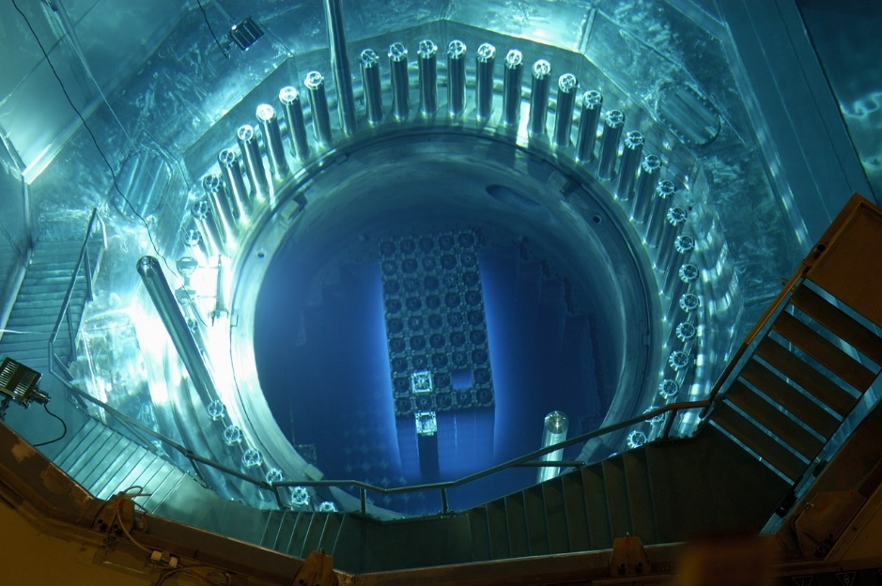




7th Kazakhstan International Exhibition “Nuclear Energy and Industry”
6th Kazakhstan International Exhibition “Energy, Electrical Equipment and Power Engineering”
4th Kazakhstan International Exhibition “Machine Building, Machine-Tool Building and Automation”
2nd Kazakhstan International Exhibition “Non-Destructive Testing and Technical Diagnostics”
Astana, Kazakhstan
Post Show Report 2016
Next Event: 26-27 April 2017, Astana, Kazakhstan
www. machexpo.kz, www.ndtexpo.kz
Notes:
Remember why we publish Post Event Reports. They are designed to provide exhibitors and prospective exhibitors with useful information. It should be published as soon as possible after the event and it should be easy to access.
Too much information, or too much detail, will not enhance the document. It is foolish for us to think that our customers are interested in, or have the time to read lengthy reports. This information (and more) should be available on the event website – make sure that content is transferable.
If you wan to produce an effective report – keep it smart, clear and concise.

Slide 2
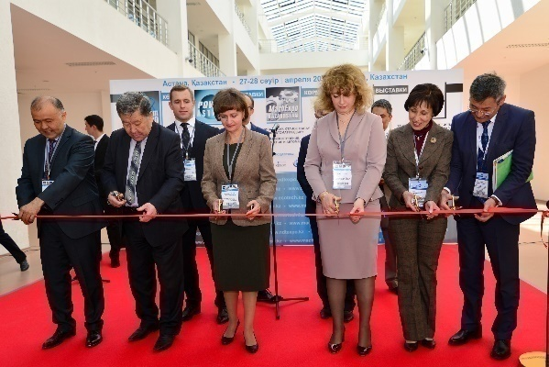
MachExpo 2016
Power Astana 2016
Kazatomexpo 2016
NDT Kazakhstan 2016
The industrial exhibitions were held in the capital of Kazakhstan
The official opening ceremony of the exhibitions was attended by: the Deputy Chairman of the Committee of Nuclear and Energy Supervision and Control of the Ministry of Energy of the Republic of Kazakhstan E.A. Karentayev, the Director of the Department of “Green Economy” of the Ministry of Energy of the Republic of Kazakhstan B.D. Kerey, the Director of the Department of Waste Management of the Ministry of Energy of the Republic of Kazakhstan Zh.I. Nurbekov, the Chairman of Kazakhstan Electricity Association Sh. A. Urazalinov, the General Director of “Rosatom – Central Asia” S.S. Gromov, the Executive Director of the Nuclear Society of Kazakhstan N.A. Zhdanova, the President of Kazakhstan Association of Non-Destructive Testing and Technical Diagnostics S.A. Zaitova, the Deputy Chairman of the Board of the Union of Machine Builders of Kazakhstan T.I. Altayev, the Sales Director of Iteca company B.A. Danilenko.
Mr. Karentayev in his speech noted that extensive collaboration of technical experts, entrepreneurs, scientific community and others who invest their skills, knowledge and energy in it, plays an important role in the modern world for the effective development of the high-tech industries as the nuclear and energy industries. Holding such exhibitions will contribute best to establishing and strengthening of technical, scientific and economic cooperation in the sphere of peaceful uses of nuclear energy and the development of nuclear, engineering and energy industries.
Dates: April 27-28, 2016
Venue: “Korme” EC, Astana, Kazakhstan
Frequency: Annually
Notes:
Exhibitors want to know who attended the event. The basic numbers are obviously important, but other information might also be useful. This slide has room for several charts and graphs that can be used for breakdowns such as visitors by: area of interest, level of purchasing authority, job function, region, reason for attending etc.
Please make sure that the information published is well presented and positioned neatly on the page.

Slide 3
Visitors:
Post Show Report
Visitors geography
Job titles
Level of responsibility for making decisions on signing contracts at the exhibition
The importance of visiting exhibitions for business
General satisfaction with the exhibition
Procurement planning based on the results of visiting the exhibition
Notes:
Exhibitors want to know who attended the event. The basic numbers are obviously important, but other information might also be useful. This slide has room for several charts and graphs that can be used for breakdowns such as visitors by: area of interest, level of purchasing authority, job function, region, reason for attending etc.
Please make sure that the information published is well presented and positioned neatly on the page.

Slide 4
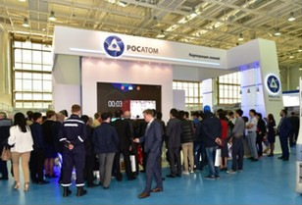
Exhibitors:
Post Show Report
\**
The exposition was presented by more than 55 companies from Belarus, Germany, Italy, Kazakhstan, China, Russia, Ukraine, the Czech Republic and Switzerland.
Among the participants there were the producers and suppliers of energy equipment; cable products; instrumentation, process control and monitoring systems in various industries; automated energy accounting systems; machine tools for different purposes and many others.
“ZETO” CJSC, “Zavod Invertor” JSC, “Engineering Centre for Energy Efficient Lighting Technology” LLC, “Silovye Mashiny” OJSC, “Em-Kabel” LLC, “Energomera Electrotechnical Factories” JSC, “Energokomplekt” PA, Guhring Ug, the Scientific Research Institute of Light Sources named after A.N. Lodygin, “Enterprise for Radioactive Waste Management “ROSRAO” FSUE, REAL STEEL and other companies introduced their developments.
The pavilion of the industrial enterprises of Russia, where the participants demonstrated the latest equipment, technology and engineering solutions in the sphere of electrical engineering, technical diagnostics in industry; machine building and industrial safety, was presented within the overall exposition. The organizer of the Russian exposition was the “Atomexpo” company .
“Rosatom” State Corporation demonstrated the collective stand with a wide range of innovative products and services of the Russian nuclear power complex, perspective projects implemented in Russia and abroad. Also, the representatives of “Rosatom” organized special events for senior schoolchildren and students, which included a variety of mind games and educational activities.
Notes:
Although exhibitors and prospective exhibitors are more likely to be interested in who visited the event, they will also be keen to see if the actual exhibitor profile meets with their approval. In other words, they need to know if this is the right event for them.

Slide 5
Exhibitors Survey:
Post Show Report
The importance of participation for business
Evaluating return on investment after participating in the exhibition
Achievement of the objectives of participation in the exhibition
General satisfaction with the exhibition
Notes:
Although exhibitors and prospective exhibitors are more likely to be interested in who visited the event, they will also be keen to see if the actual exhibitor profile meets with their approval. In other words, they need to know if this is the right event for them.

Slide 6
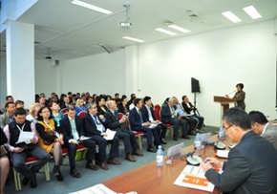
Business program:
Post Show Report
On April 28 the Ministry of Investments and Development of the Republic of Kazakhstan and the UNDP conducted seminars on “Energy Saving and Increasing Energy Efficiency in the RK”. Kazakhstan Association of High-Tech, Energy Efficient and Innovative Companies conducted a series of seminars for industrial and energy companies.
Also, “Nuclear Society of Kazakhstan” held the master class and the team game “Competition for the Best in Nuclear Power Plants Construction” within the framework of the Exhibition’s business program . The company “Inkab” prepared the seminar on “Optical Cables Embedded in Ground Wire - Modern Effective Solutions”.
On April 28 the representatives of the Ministry of Investments and Development of the RK, the Ministry of Energy of the RK, the Procurement Department of the NCE of the RK, “National Agency of Development of Local Content “NADLoC” JSC, “Samruk-Kazyna” JSC, and also the large industrial enterprises participated in the Round Table on: “Interaction Problems of Producers and Enterprises on Recycling”, focused on the discussion of issues of compliance with the laws in the sphere procurement of the Republic of Kazakhstan.
Notes:
For conferences, delegates might be interested in a variety of information. Depending on the size of the event, you may wish to publish a list of key speakers, or (as above) the organisations represented by the delegates

Slide 7
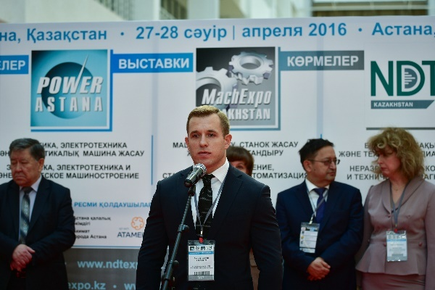
MachExpo 2017
Power Astana 2017
Kazatomexpo 2017
NDT Kazakhstan 2017
For enquires regarding participation, please contact :
Gulzana Abdusharipova :
+7 (727) 258 34 34
Gulzana@iteca.kz
Madina Kurmangaliyeva :
+7 (727) 258 34 34 (вн.233),
Madina.kurmangaliyeva@iteca.kz
More information is on the event website: www. machexpo.kz, www.ndtexpo.kz
Dates: April 27-28, 2016
Venue: “Korme” EC, Astana, Kazakhstan
Frequency: Annually
Notes:
Ultimately, we want people to consider booking their exhibition space or delegate place at the next event. Make it easy for them to get in touch. Do not be tempted to overload this page with lots of contacts. The international and domestic sales managers should be able to field all enquiries and pass the details on to the appropriate sales person or agent.

